Slide 1
SP-2 Team 9 zyzrag
Team Members:
Darrus Goh(Pilot)
Neo Zheng Rong(Gunner)
Wong Keng Han Ashley(Droid)

Slide 2
overview
Game Overview:
Drive around your ship and shoot at asteroids coming towards your station.
Place down ships to help you defend.
Command your ally ships to destroy asteroids.
Earn money by destroying asteroids buy ships and upgrade your ship to survive!
Survive for as long as possible before the inevitable happens…

Slide 3
Video!

Slide 4
Controls
Button | Action
W,A,S,D | Movement
E | Interact with Objects
Escape | Quit Game, Leave Shop
Tab | Change between RTS and Ship/Station
1,2,3 | Selection ships to place down in RTS mode
Left Click | RTS: Select Ship/Place ship In Player Ship: Fire Bullet In Shop Menu: Purchase items
Mouse Movement | Camera movement
Alt | Change Camera mode while in RTS Mode.

Slide 5
Features
Unit Controls:
Move around units and make them chase after asteroids to destroy them.
Controlling player ship:
Drive around player ship and kill asteroids
Shop:
Upgrade player ship/ buy new ships to place!

Slide 6
Task List

Slide 7
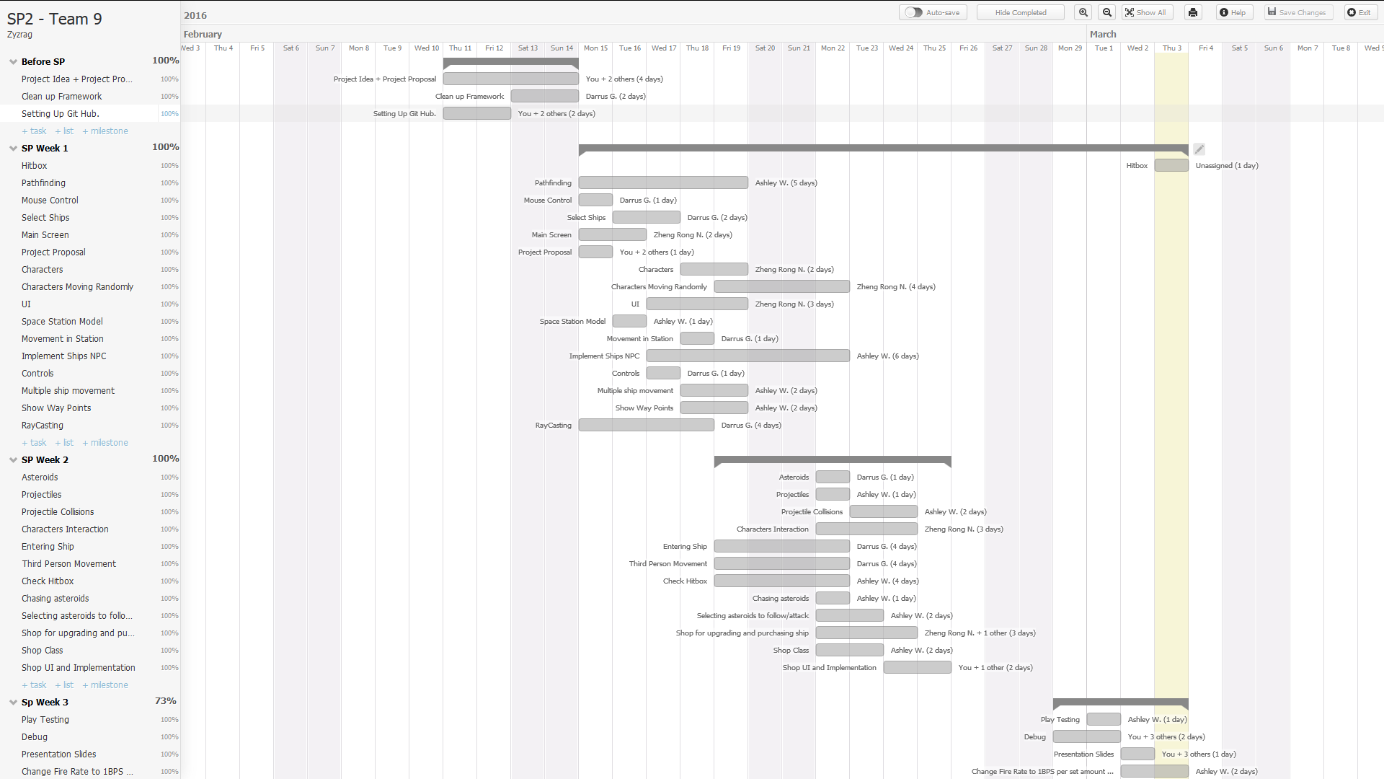
Gantt chart

Slide 8
Problems we faced
We did not know how to check for unit selection.
We looked up on ray casting and were able to do unit selection.
Lack of Time
We cut features as we did not have enough time to do.
Memory LEAK!
Reassigning mesh makes new pointers causing program to take a long time to close.

Slide 9
interaction
Talking to NPCs !
Selecting Ships!
Shop to purchase ships and upgrade!
Moving Ships around!
Shooting and Destroying Asteroids!

Slide 10
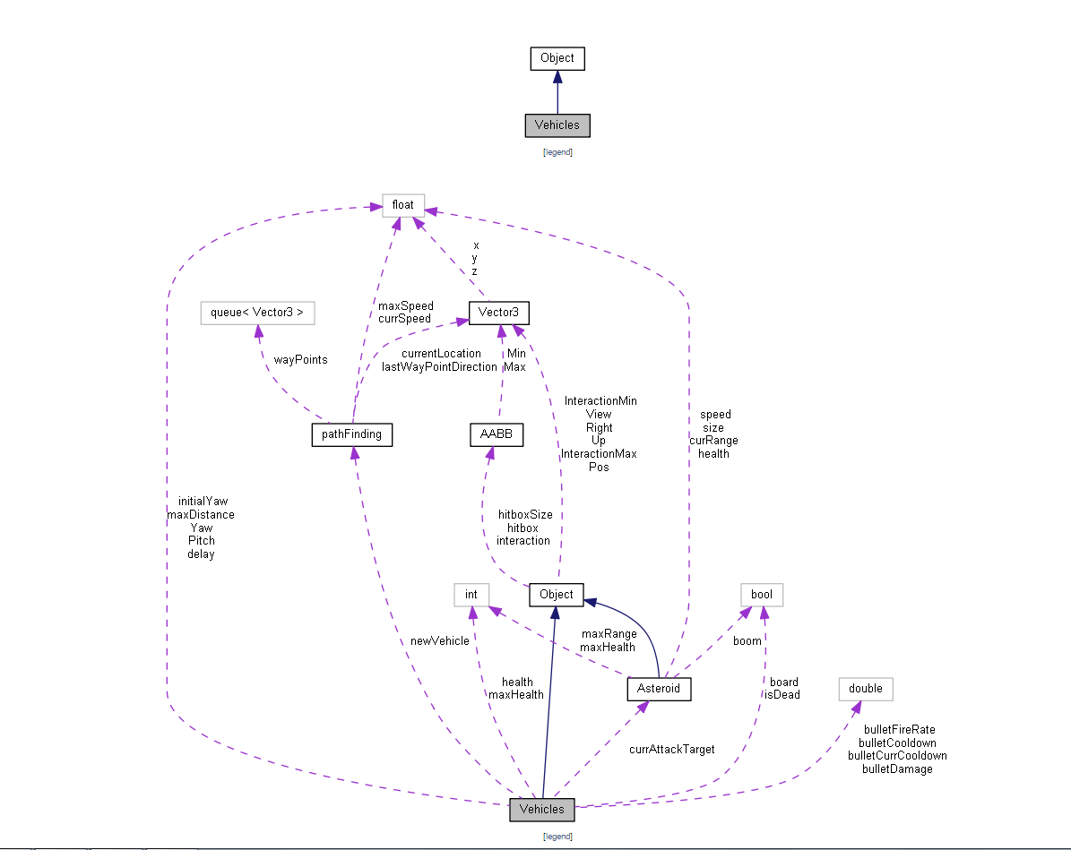
UML Diagram

Slide 11
Best and worst of sp!
Best:
Our Team is very compromising and we had only few conflicts that were easily resolved.
Worst:
We lost one of our member during the first week of SP and we felt that we needed to work harder.

Slide 12
Things we could have done better
More features could have been implemented if we had better time management.
Our codes could be neater.
Features could be made to be more efficient

Slide 13
Thank you!

